Slide 1
Welcome to Technical Bootcamp: Day 4

Slide 2

A look into the Day 4 agenda
Day 4
Challenge Introduction
Begin POC Challenge
Please refer to the descriptions below for reference
Types of activities:
Attendees will participate in four different types of activities:
Break
Continue POC Challenge
Keynote
Labs
Break
Continue POC Challenge
Presentations
Challenges
Teams Cohort Activities
Long Break
Location of activities:
Each activity will take place in the following location:
Finish POC Challenge
Challenge Debrief
All-up Session: Teams bridge in calendar invite
Closing
Teams Cohort: “Meet Now” function in Teams Cohort Teams channel
Independent working time: No meeting, working in Spektra labs

Slide 3

Your challenge should you choose to accept it:
Wide World Importers needs your help!
Work as a team and prove to them you have what it takes.
It won’t be easy alone, but as ONE Microsoft, you can do this!
Complete as many of the challenges as you can, but don’t worry about getting them all done.
This Photo by Unknown Author is licensed under CC BY

Slide 4

Not allowed
Scaling SQL Pools up
Working in other SQL Pool schema than wwi_poc
Using other files from the data lake to import sales data other than the ones explicitly mentioned in the description of the challenge
This Photo by Unknown Author is licensed under CC BY

Slide 5


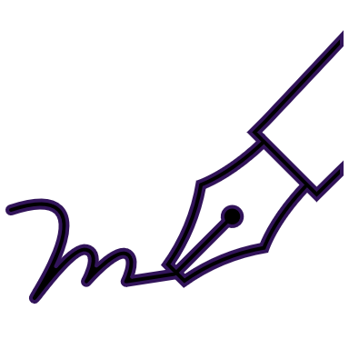



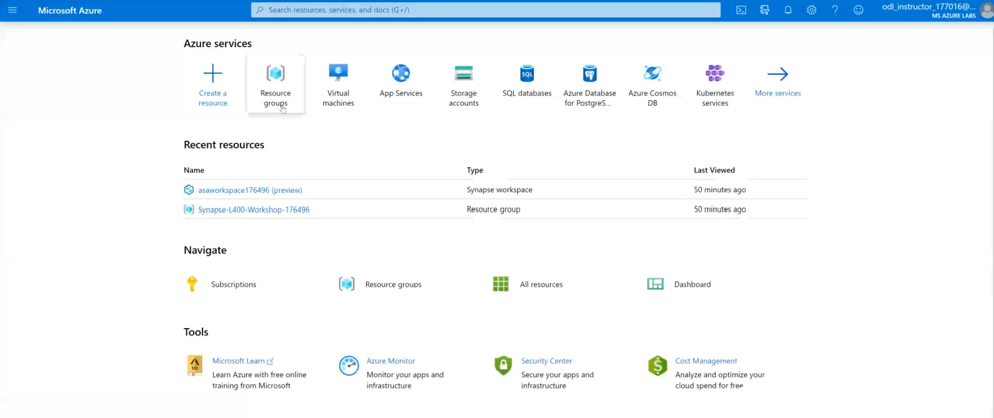

POC Challenge: group-based lab exercise
GUIDE:
PoC Challenge
https://github.com/solliancenet/data-ai-technical-bootcamp/
Step 1: Go to your table group channel
Step 2: You will use your cloud lab login for Azure
Step 3: Login to Azure. Engage your table group via a Microsoft Teams “meet now” call to collaborate with each other (meet now button in upper right corner of application)

Slide 6

What we covered and how to continue to learn
Thank you for participating
What was covered this week:
Together we learned how to develop performant Azure Synapse Analytics proof-of-concepts using the latest functionality for data ingestion, transformation, query optimization, security, monitoring, and machine learning.
How to keep learning:
Watch and learn with Microsoft Build
Explore Microsoft.com/learn for on-demand learning
Connect with us in our upcoming Architecture Design series

Slide 7
A few takeaways
Never trust already existing data or structure
Make sure you run your data processes “pedal to the metal”
Always work on small subsets first
Assume all files are “bad” – “good” is just a nice surprise
Fail fast, change optics even faster
Don’t be shy of moving out of the SQL world
Think outside of the box
Explore first, then understand, then “solve”

Slide 8
A few (more general) takeaways
The days of “I know only SQL” and “I’m a pure DE/DS, I hate SQL” are gone
A PoC is all about the end result – there is no price for “elegance”
A 360 degree view on Synapse is critical to success

Slide 9
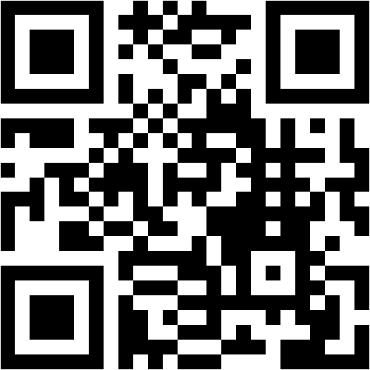
Mentimeter Poll
Scan QR Code
or Go to www.menti.com and use code
20 44 69 9

Slide 10
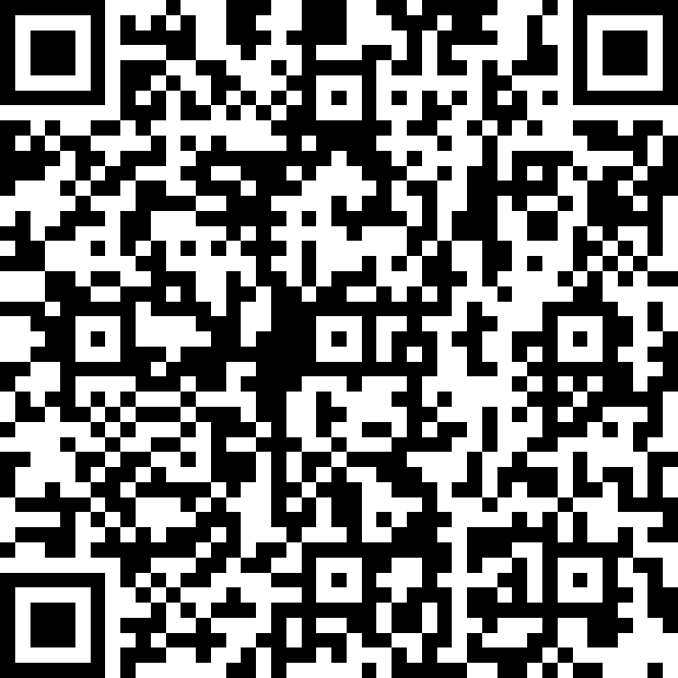
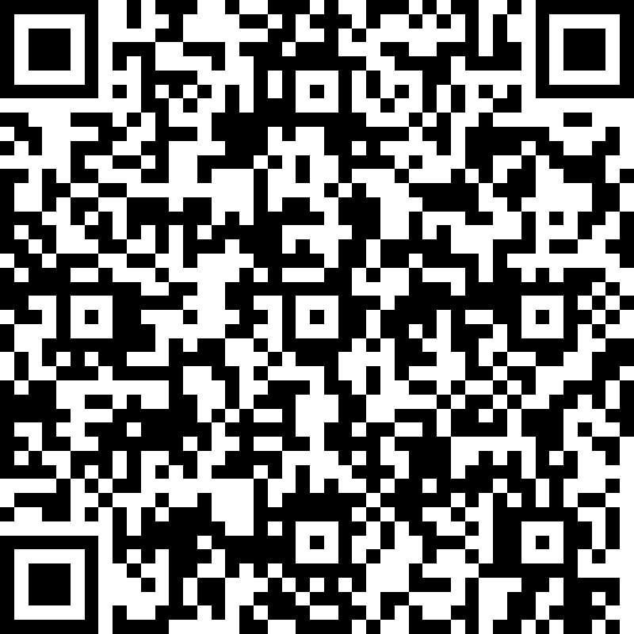
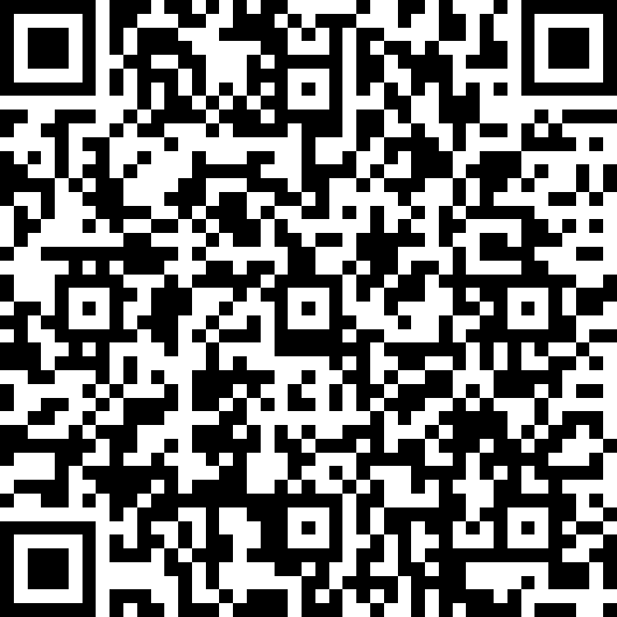
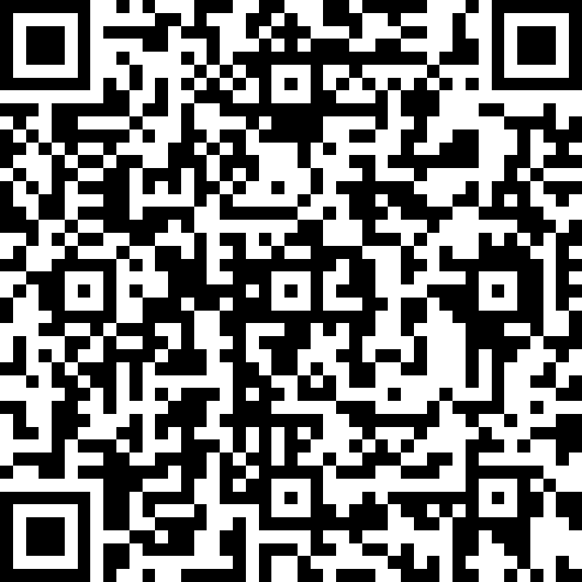
We’d love to hear from you!
Day 1 | Day 2 | Day 3 | Day 4
Scan the QR code below using your smartphone or access the link https://aka.ms/BC_EMEA_Day1 You’ll also receive a link to this survey by email. You only need to complete it once. Answer the survey questions to provide your feedback on Day 1 of Boot Camp. Be honest. Every bit of feedback helps us improve. | Scan the QR code below using your smartphone or access the link https://aka.ms/BC_EMEA_Day2 You’ll also receive a link to this survey by email. You only need to complete it once. Answer the survey questions to provide your feedback on Day 2 of Boot Camp. Be honest. Every bit of feedback helps us improve. | Scan the QR code below using your smartphone or access the link https://aka.ms/BC_EMEA_Day3 You’ll also receive a link to this survey by email. You only need to complete it once. Answer the survey questions to provide your feedback on Day 3 of Boot Camp. Be honest. Every bit of feedback helps us improve. | Scan the QR code below using your smartphone or access the link https://aka.ms/BC_EMEA_Day4 You’ll also receive a link to this survey by email. You only need to complete it once. Answer the survey questions to provide your feedback on Day 4 of Boot Camp. Be honest. Every bit of feedback helps us improve.

